Slide 1
Community Air Protection Program
Incentive Grants
CAPP Workshop
June 8, 2021

Slide 2
Workshop Goals
Provide information about the Community Air Protection Program Incentive Grants
Show projects currently available which meet program requirements
Seek public input on program priorities

Slide 3
Assembly Bill 617
Approved July 26, 2017
Community Air Protection Program
  focus on emissions reductions in disadvantaged communities (DACs)
  reduce emissions where there is a high air pollution burden

Slide 4
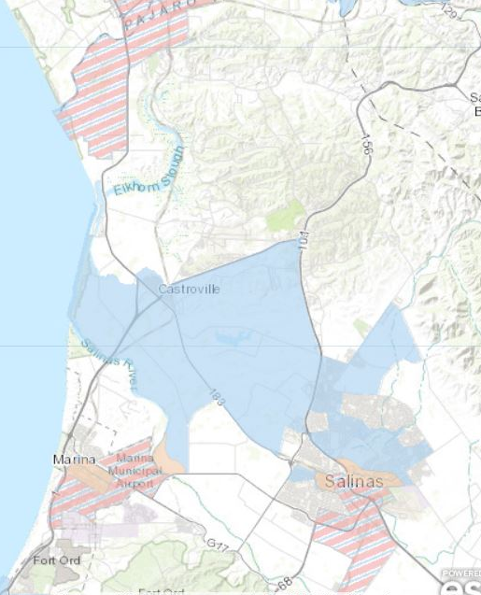
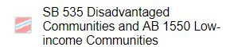
Community Identification
Disadvantaged Communities
  CalEnviroScreen 3.0 Map
    Scored by Multiple Factors:
      Pesticides
      Housing burden
      Impaired water
      Poverty
      Unemployment
        Census Tracts in top 25%

Slide 5
Community Identification
Adversely affected by emissions sources in DACs with a high cumulative exposure burden
Goal to reduce criteria pollutants and toxic air contaminants within these communities
Statewide goal for 70% of funds spent in DACs and 80% in Low-Income Areas

Slide 6
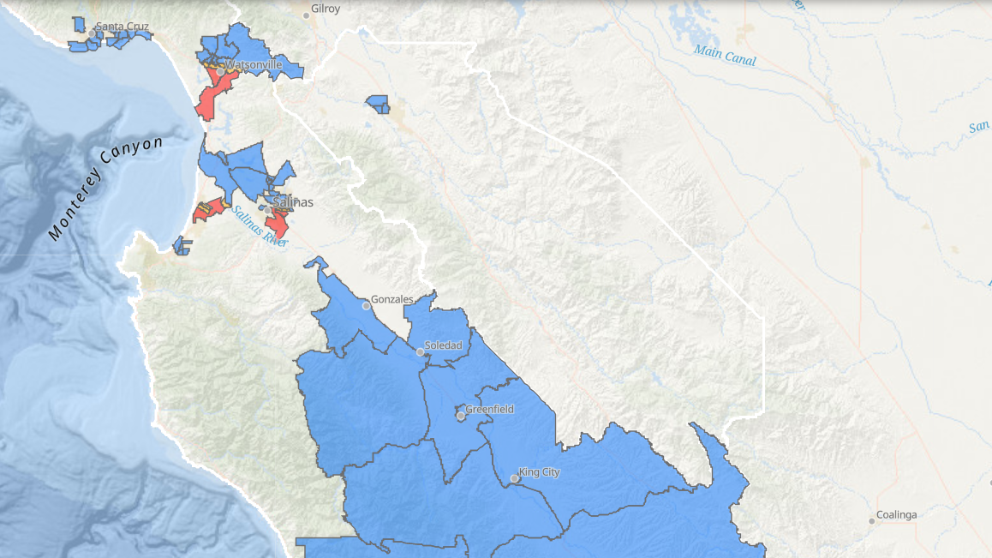
CAPP Priority Areas

Slide 7
AB 617 Incentive Grant Awards
Year 1 - $655,000
Year 2 - $1,638,062
Year 3 – $1,289,877
  Use Carl Moyer Program Guidelines
  Located in DACs
  Requires outreach

Slide 9
Allowable AB 617 Project Types
Mobile source projects - Moyer Program
Zero-emission vehicle charging infrastructure
Stationary source equipment replacement
Community-identified

Slide 10
CAP Program Eligible Project Types
Zero-emission Equipment Replacements
  Agricultural irrigation pumps
  School buses
  On-road Medium to Heavy Duty Trucks
  Charging infrastructure
Off-Road Equipment Replacements
  Tractor, loader, forklift, grape harvesters, marine engines

Slide 11
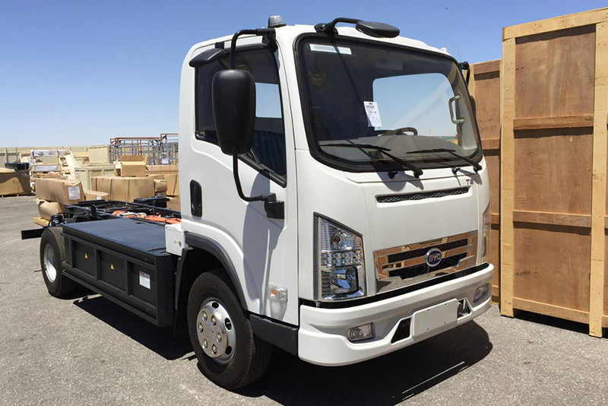
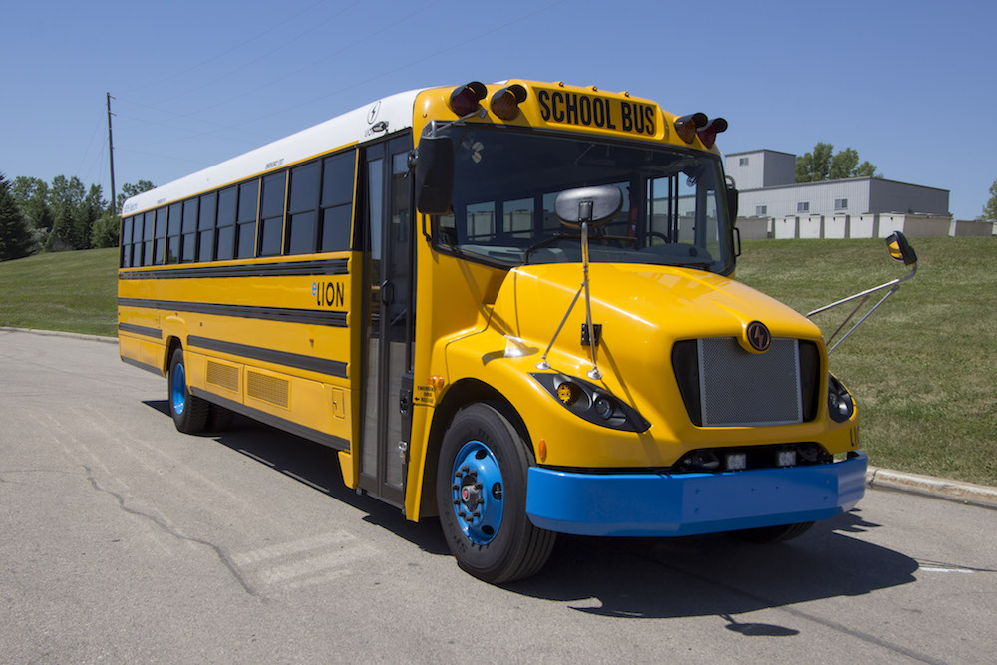
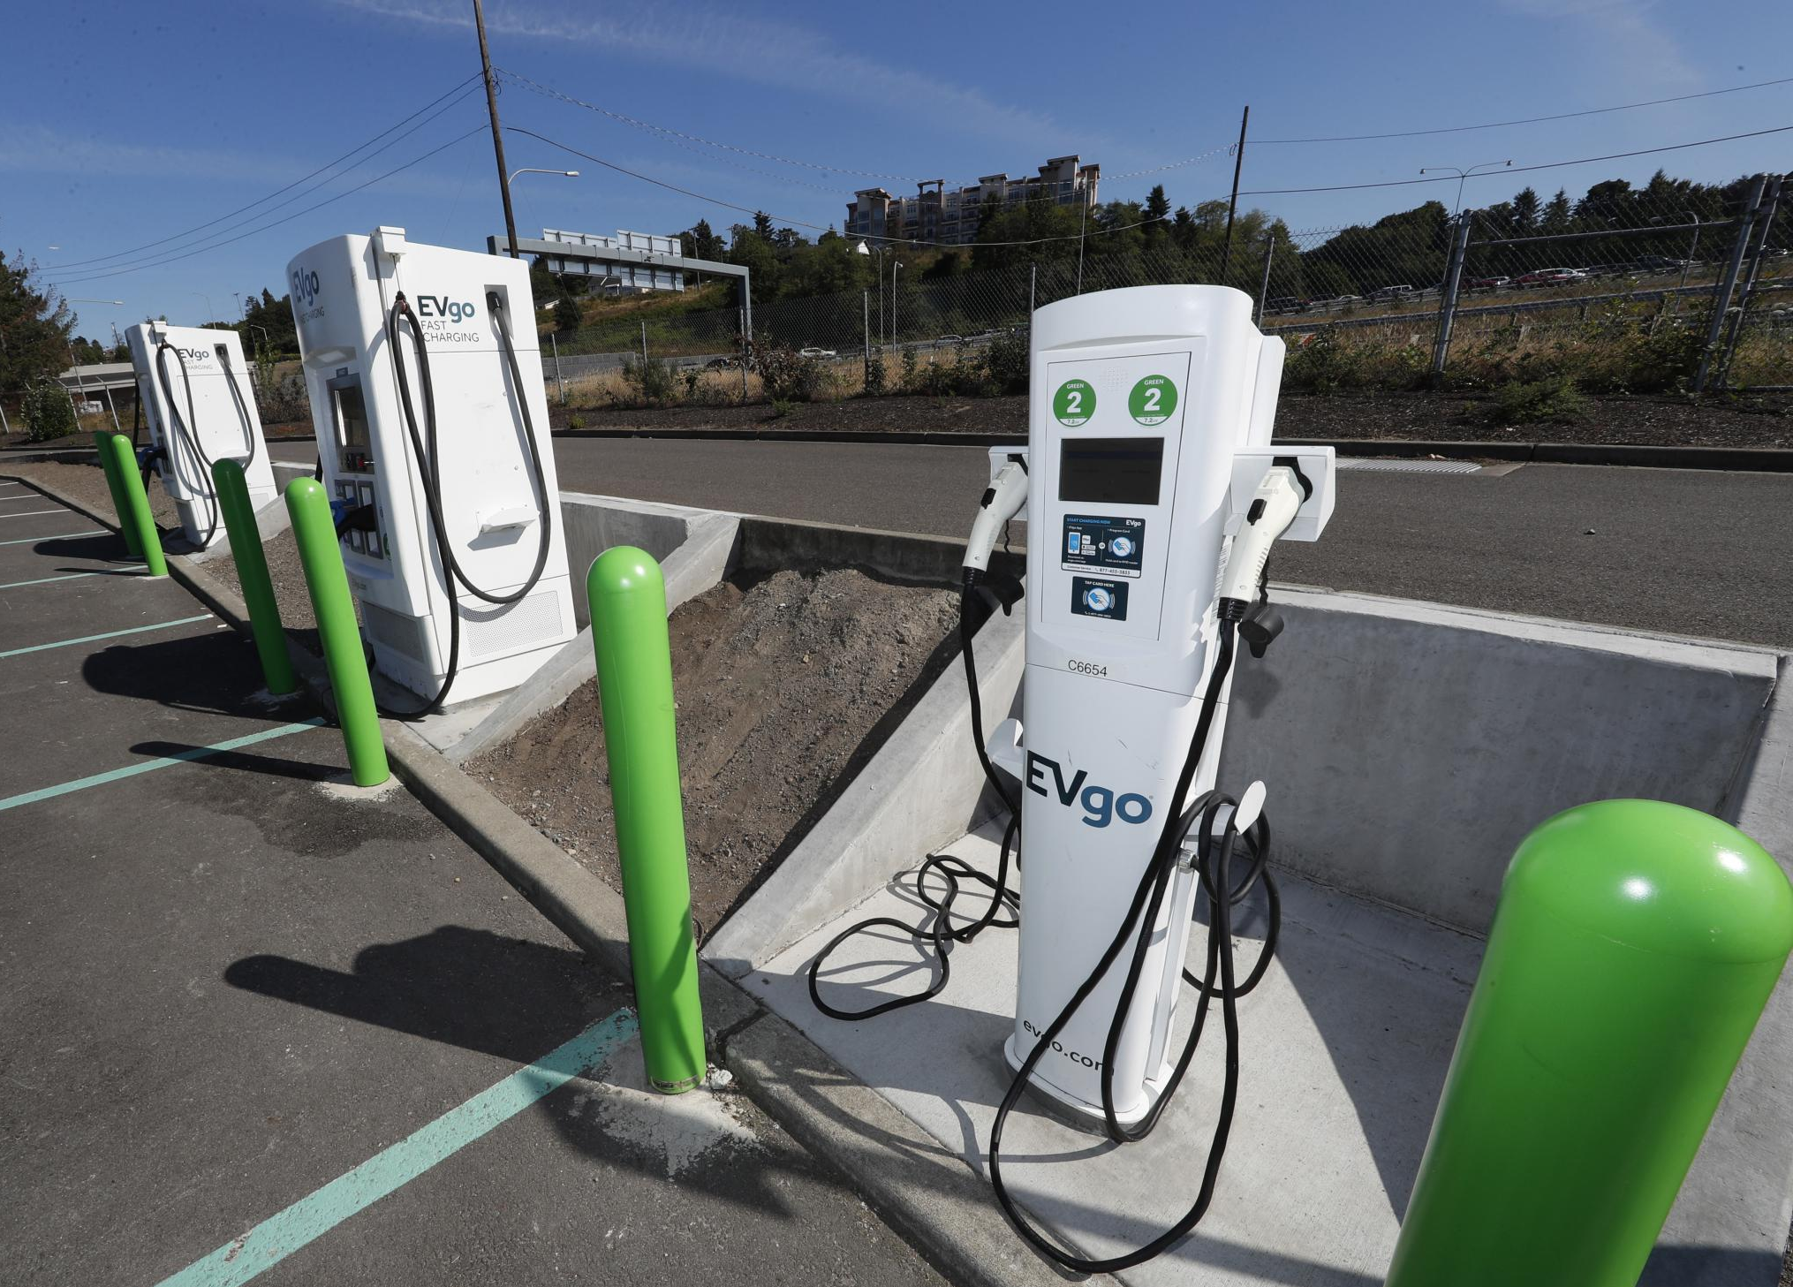
Notes:
Project Type Examples

Slide 12
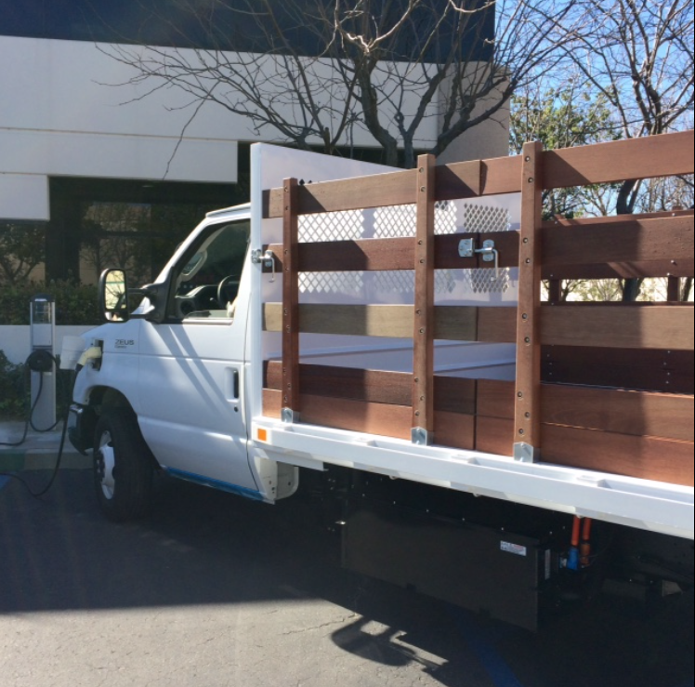
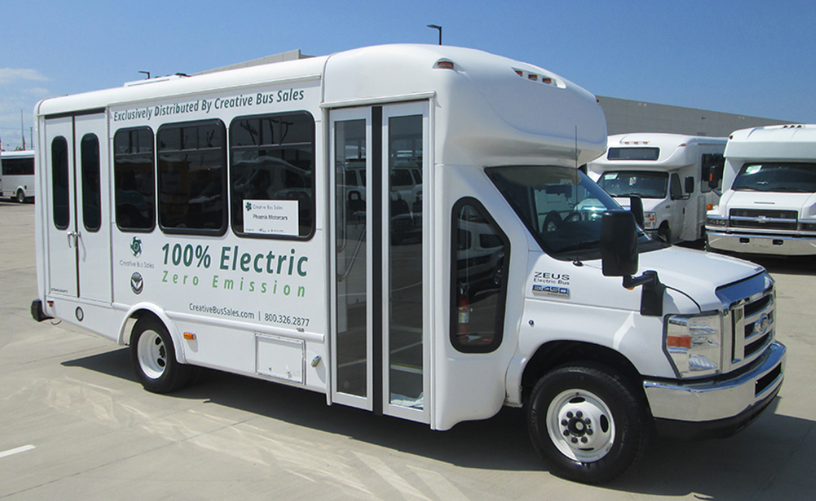
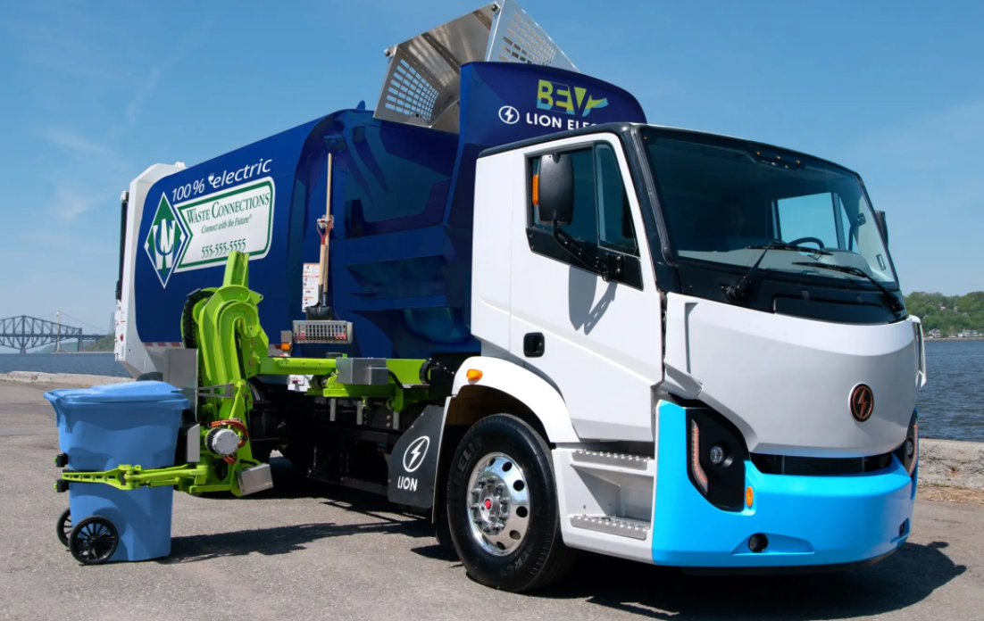
Notes:
On Road Example & Infrastructure

Slide 13
Funding Prioritization
Clearly defined prioritization:
  Disadvantaged Community (DAC)
  Low-income Area (LI)
  Zero-emission project
  Project Cost Effectiveness

Slide 14
Delivered Electric School Buses to DA/LICs
Santa Rita Union School District
Alisal Union School District
Chualar Union School District
Gonzales Unified School District
Greenfield Union School District
San Antonio Union School District
Monterey County Office of Education
Live Oak Elementary School District
Santa Cruz City Schools

Slide 15
On-Road & Electrification Funding
Category | Project Type | Max Funding % | Max Funding $$
On-Road | Zero-Emission School Bus | N/A | $ 400,000
 | “” Transit Bus | N/A | $ 80,000
 | “” HHD Truck / Bus (GVWR > 33,000 lbs.) | N/A | $ 200,000
 | “” MHD Truck / Bus (GVWR 19,501- 33,000 lbs.) | N/A | $ 150,000
 | “” LHD Truck / Bus (GVWR 14,001- 19,500 lbs.) | N/A | $ 80,000
EV Infrastructure | All Projects | 50% | N/A
 | Publicly Accessible Projects | 60% | N/A
 | Projects with Solar/Wind Power Systems | 65% | N/A
 | Publicly Accessible Projects with Solar/Wind Power Systems | 75% | N/A
 | Public School Buses – Charging | 100% | N/A

Slide 16
Potential CAPP Year 3 On-Road Projects

Slide 17
Questions/Comments?
David Frisbey
Planning and Air Monitoring Manager dfrisbey@mbard.org
(831) 718-8016
For Diesel Engine Replacement Grants:
Hanna Muegge
Air Quality Planner II
hmuegge@mbard.org
(831) 718-8021
For On-Road Zero Emission Grants:
Alan Romero
Air Quality Planner III
aromero@mbard.org
(831) 718-8030

